Slide 1
Process Models

Slide 2
Overview
The roadmap to building high quality software products is software process.
Software processes are adapted to meet the needs of software engineers and managers as they undertake the development of a software product.
A software process provides a framework for managing activities that can very easily get out of control.
Modern software processes must be agile, demanding only those activities, controls, and work products appropriate for team or product.
Different types of projects require different software processes.
The software engineer's work products (programs, documentation, data) are produced as consequences of the activities defined by the software process.
The best indicators of how well a software process has worked are the quality, timeliness, and long-term viability of the resulting software product.
Notes:
2

Slide 3
Software Process
Framework for the activities, actions, and tasks required to build high quality software
Defines approach taken as software is engineered
Adapted by creative, knowledgeable software engineers so that it is appropriate for the products they build and the demands of the marketplace
Notes:
3

Slide 4
Process Flow
Describes how each of the five framework activities, actions, and tasks are organized with respect to sequence and time
Linear process flow executes each of the framework activities in order beginning with communication and ending with deployment
Iterative process flow executes the activities in a circular manner creating a more complete version of the software with each circuit or iteration
Parallel process flow executes one on more activities in parallel with other activities

Slide 5
軟體生命週期
軟體由產生至結束的演繹過程
軟體由一群程式碼模組與資料組成
  軟體如何產生?
  軟體運作時會因什麼緣故而作改變?
  軟體退休前該作何處理?
分7 phases(階段): requirements, specification, design, implementation, integration, maintenance, and retirement.
軟體生命周期前五個phases (軟體的產生software development)的發展模式，亦稱軟體發展模式(software development model)

Slide 6
主要模式：
  Build-and-fix model
  Waterfall model
  Rapid prototyping model
  Incremental model
  Synchronize-and-stabilize model
  Spiral model
  Object-oriented life-cycle models

Slide 7
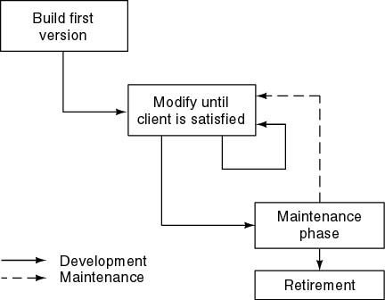
Build and Fix Model ( 1 of 2)

Slide 8
Build and Fix Model ( 2 of 2)
The product is constructed without any specification or any attempt at design.
Rework as many times as necessary to satisfy client.
適用於小系統(100 to 200 lines of code)及個人單獨發展
問題:
  缺乏發展制度及規劃,由錯誤中學習
  靠成品與客戶溝通,猜測客戶需求
  不適用眾人合作發展,且缺乏效率
→應有階段及檢核點觀念,方能循序且系統化發展

Slide 9
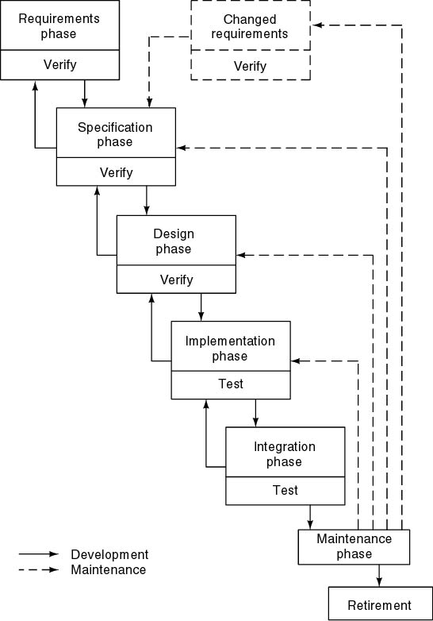
Waterfall Model (1 of 3)

Slide 10
Waterfall Model (2 of 3)
依life cycle階段,一階段工作完成後才進入下階段
Characterized by
  Documentation-driven
  Feedback loops (by formal review)
Activities, rules of team work and documentation standard of each phase are defined. → Engineering approach
Development methods and processes are proposed
  Structured programming, structured design, structured analysis
  Functional- or data-oriented approaches

Slide 11
Waterfall Model (3 of 3)
Advantages
  Documentation complete
  Maintenance easier
Disadvantages
  Client can see the product only after the entire product has been coded
  Client不易由specification掌握未來產品的性能 →共識性不足,易生爭議及反悔
  一階段未通過則不能往下走,人員易閒置
Suitable to the project with previous experience. ←有樣板可參考,較易產生共識及減少錯誤發生

Slide 12
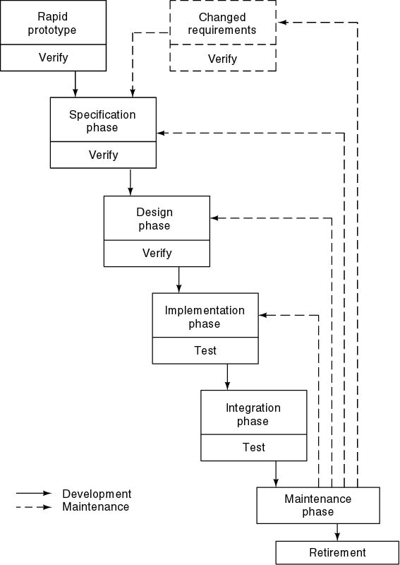
Rapid Prototyping Model (1 of 4)

Slide 13
Rapid Prototyping Model (2 of 4)
Experience learned
  Requirement capture is the most difficult job.(講不清楚,未提到…)
  If requirement or specification is not fixed, design team and coding team will be idle.
  Wrong requirement leads wrong design and code, all development should be started again.
Solution: Use prototype to help users to list requirements
  Static prototype (由紙畫出輸出入畫面,以解釋未來運作)
  Working prototype: code or executable specification

Slide 14
Rapid Prototyping Model (3 of 4)
A rapid prototype is a working model that is functionally equivalent to a subset of the product.
Once the working model has been accepted by client, the development is almost straightforward.
Rapid prototyping may replace specification phase, never the design phase
Advantage
  Easy to get true requirements and to define specification
  “Rapid”

Slide 15
Rapid Prototyping Model (4 of 4)
Disadvantage
  The working prototype will be discard.
  Nonfunctional requirements are not easy to be implemented and verified in prototype.
  The architecture may not be good. (只為驗証規格的正確性,系統架構未深入分析及設計,工程師若繼續沿用,產生不良後果)
Suitable to exploring project(創新型專案)
  需求及規格較不易明確訂定,客戶與發展者需對需求與規格有必要多溝通以求共識”

Slide 16
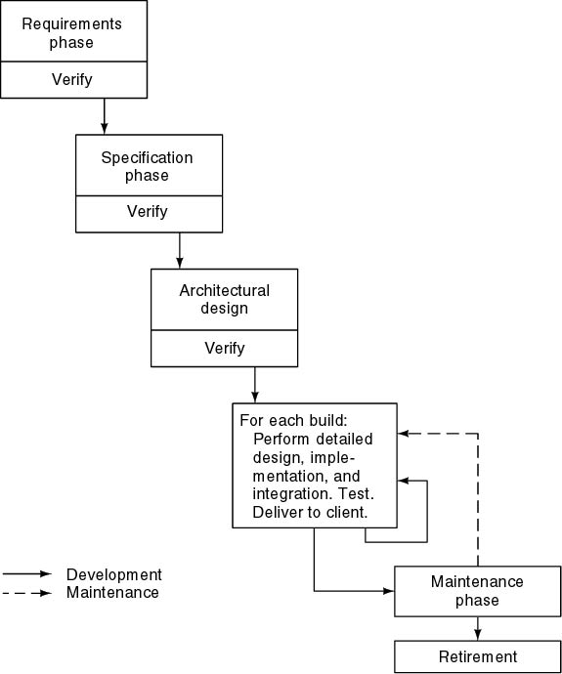
Incremental Model (1 of 6)

Slide 17
Incremental Model (2 of 6)
Experience learned
  Executable specification language suitable for all applications is not easy designed.
  Software is built, not written. (Software is constructed step by step, in the same way that a building is constructed.
User is difficult to list all requirements at one time, but is easy to list most important and frequently used requirements. →incomplete specification issue
先作部份成品供客戶使用,驗證其正確性及發覺不足之處

Slide 18
Incremental Model (3 of 6)
Waterfall, rapid prototyping models
  Operational quality complete product at end
Divide project into builds, where a build consists of code pieces from various modules interacting together to provide a specific functional capability (i.e. meet some requirements). The software product is designed, implemented, integrated, and tested as a series of incremental builds (逐漸增加功能).
Incremental model
  Operational quality portion of product within weeks
  10 to 50 builds for a typical product

Slide 19
Incremental Model (4 of 6)
己有的build(s).可提供客戶試用以確定符合其需求,因此用戶可及早看到成果。→Smaller capital outlay, rapid return on investment
Still need a long time to capture requirements and to define specification ( user is difficult to list all requirements at one time, but is easy to list 50% requirements)
  User will list other requirements incrementally after he use the build(s).
Need open architecture—maintenance implications
可平衡人員運用及加速發展的運作方式

Slide 20
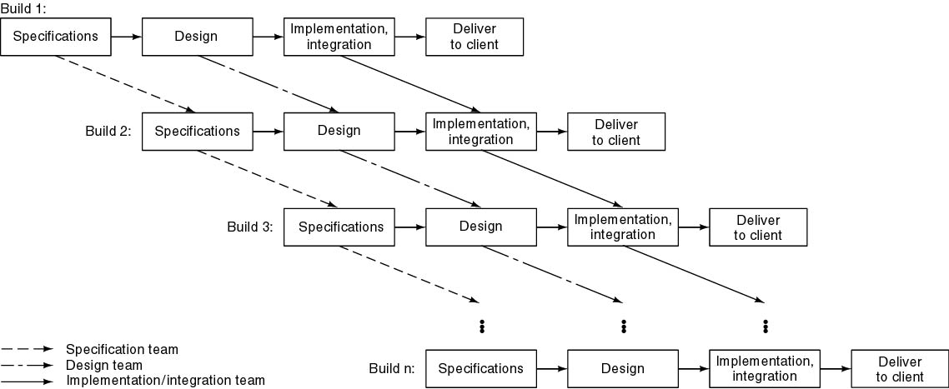
Incremental Model (5 of 6)

Slide 21
Incremental Model (6 of 6)
Problems
  Build-and-fix danger →若 build錯誤太多,導致control of the whole process can be lost
  Contradiction in terms: View the product as a whole, but simultaneously view the product as a sequence of builds
  →Risky incremental model,偏離焦點
需有明確發展規劃,及控制build的正確性

Slide 22
Synchronize-and Stabilize Model
Microsoft’s life-cycle model
Requirements analysis—interview potential customers
Draw up specifications
Divide project into 3 or 4 builds. The first build consists of the most critical features, the second build consists of the next most critical features, and so on.
Each build is carried out by small teams working in parallel

Slide 23
Synchronize-and Stabilize Model
Synchronize-and-stabilize is a software life cycle development model. It allows the teams to work efficiently in parallel on different individual application modules. This is done while frequently synchronizing the work as individual’s and as members of parallel teams and periodically stabilizing and/or debugging the code through out the development process.

Slide 24
Synchronize-and Stabilize Model
At the end of the day: synchronize (test and debug)
At the end of the build: stabilize (freeze build)
Advantage: Components always work together
  Get early insights into operation of product
Can be used even if specification is not complete.
Only one final build is selected.
適用於Exploring project (尤其是software package): need creative idea, use parallel group to create new idea.
Good but not perfect process model
  Not all projects are successful
  High Cost

Slide 25
Synchronize-and Stabilize Model
Advantages:
It breaks down large projects into small segments, which teams with related skills can handle and complete efficiently.
It allows the project to move forward in a systematic way.
It allows large teams to work concurrently as small teams by dividing the work into small pieces.
It facilitates parallel teams who continuously synchronize the changes and stabilize the product at regular intervals
It makes a product team very responsive to events taking place in the market. It allows constant maintenance of the product in ready to ship state.
It provides a mechanism to incorporate customer inputs to product features and helps in prioritizing the tasks.

Slide 26
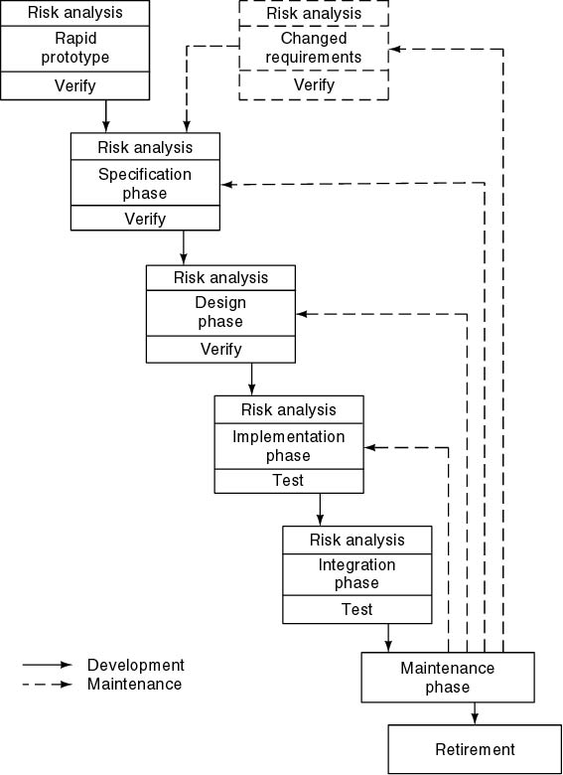
Spiral Model (1 of 5)

Slide 27
Spiral Model (2 of 5)
Exploring project: many uncertain/unknown factors.
Simplified form
  Waterfall model plus risk analysis
Precede each phase by
  Objectives and constraint
  Alternatives
  Risk analysis
Follow each phase by
  Evaluation
  Planning of next phase
If risks cannot be resolved, project is immediately terminated → risk-driven approach

Slide 28
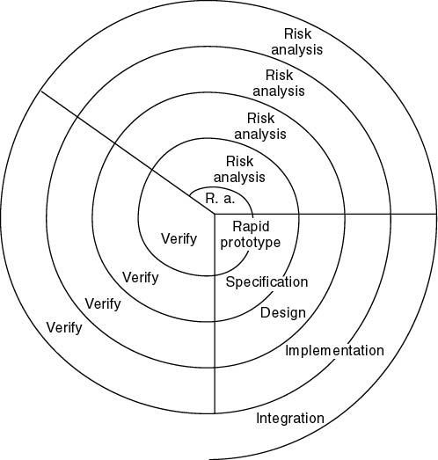
Spiral Model (3 of 5)

Slide 29
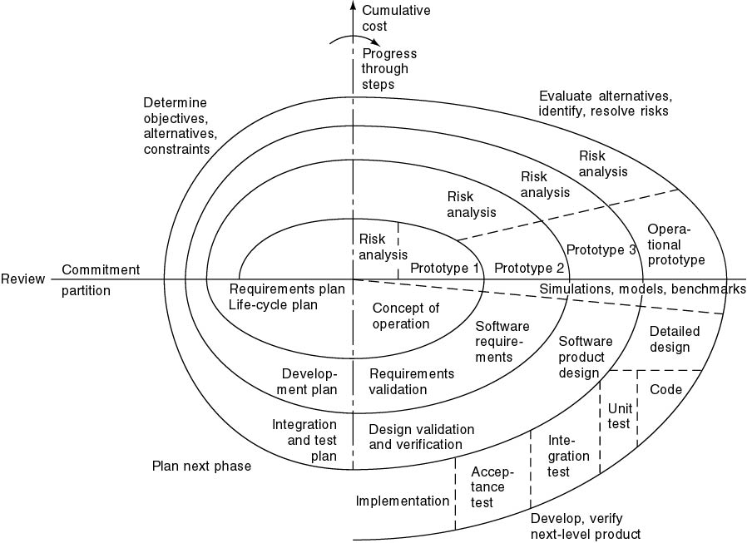
Spiral Model (4 of 5)

Slide 30
Spiral Model
一個典型的螺旋模型應該由以下的步驟構成：
  明確本疊代階段的目標、備選方案以及應用備選方案的限制；
  對備選方案進行評估，明確並解決存在的風險，建立原型；
  當風險得到很好的分析與解決後，應用瀑布模型進行本階段的開發與測試；
  對下一階段進行計劃與部署；
  與客戶一起對本階段進行評審；
Radial dimension: cumulative cost to date
Angular dimension: progress through the spiral
適用於前瞻性大型專案(如武器系統、太空計畫)

Slide 31
Spiral Model (5 of 5)
Strengths
  通過原型的建立，使軟體開發在每個疊代的最初明確方向；
  通過風險分析，最大程度地降低軟體徹底失敗造成損失的可能性；
  在每個疊代階段植入軟體測試，使每個階段的品質得到保證；
  整體過程具備很高的靈活性，在開發過程的任何階段自由應對變化；
  每個疊代階段累計開發成本，使支出狀況容易掌握；
  通過對用戶回饋的採集，與用戶溝通，以保證用戶需求的最大實現；
Weaknesses
  過分依賴風險分析經驗與技術，一旦在風險分析過程中出現偏差將造成重大損失；
  過於靈活的開發過程不利於已經簽署合同的客戶與開發者之間的協調；
  由於只適用大型軟體，過大的風險管理支出會影響客戶的最終收益；

Slide 32
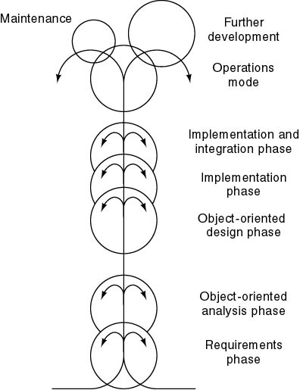
Object-Oriented Life-Cycle Models (1 of 3)

Slide 33
Object-Oriented Life-Cycle Models (2 of 3)
Object- oriented paradigm
  物件導向程式由一群 classes 組成,程式執行是一群 objects 交亙運作。
物件導向軟體發展是Seamless development:
  先定義class specification,確認系統正確性,寫code時可繼續沿用
  設計時, classes 是漸進式定義及發展
  →no waste effort
  Easy to develop incrementally
Iterative development
  “build” concept is easily adapted

Slide 34
object-oriented strategy
Object-oriented analysis,
  Functional Decomposition = Functions + Interfaces
  Information Modeling = Entities + Attributes + Relationships
  Object-Oriented = Objects + Inheritance + Message passing
Object-oriented design
  a developer applies implementation constraints to the conceptual model produced in object-oriented analysis
  a detailed description of how the system is to be built on concrete technologies
  Such constraints could include the hardware and software platforms, the performance requirements, persistent storage and transaction, usability of the system, and limitations imposed by budgets and time.
Object-oriented programming

Slide 35
Object-Oriented Life-Cycle Models (3 of 3)
Advantages of Object-Oriented Life Cycle Model:
  Design is no longer carried out independently of the later implementation because during the design phase we must consider which components are available for the solution of the problem.
  Design and implementation become more closely associated.
  Duration of the implementation phase is reduced.
  A new job title emerges, the class librarian, who is responsible for ensuring the efficient usability of the class library.
Danger
  CABTAB (Code A Bit, Test A Bit)

Slide 36
Impact of OO approach
Class: function and data should be consider together
Component concept: an independent module.
Reuse of component
  component repository → software reuse concept
  component-based development
Importance of documentation standard

Slide 37
Conclusions
Each life-cycle model has its own strengths and weaknesses
Criteria for deciding on a model include
  The organization
  Its management
  Skills of the employees
  The nature of the product
軟體產品需求與先前產品需求的類似性及產品需求的不確定性影嚮模式之選擇
只有構想，各階段的發展方法仍需提出。

Slide 38
THANKS.

